Slide 1
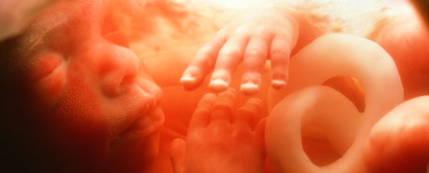
Human Reproductive system

Slide 2
Question list 1
Identify and name on diagrams of the male reproductive system: the testes, scrotum, sperm ducts, prostate gland, urethra and penis, and state the functions of these parts. (5)
Identify and name on diagrams of the female reproductive system: the ovaries, oviducts, uterus, cervix and vagina, and state the functions of these parts. (4)
Define fertilisation. (1)
State the adaptive features of sperm and explain. (4)
State the adaptive features of egg cells and explain. (2)
Compare male and female gametes in terms of size, structure, motility and numbers. (2)
Describe the whole process from fertilization to implantation (the word 'embryo' is needed)
a) Describe the function of the placenta. (3)
b) Name several toxins and pathogens that can pass across the placenta and affect the fetus. (2)
Describe the function of umbilical cord. (1)
Describe the function of amniotic sac and amniotic fluid. (3)

Slide 3
Question list 2
Outline the processes involved in labour and birth.
Describe the antenatal care of pregnant women, limited to a) special dietary needs and b) the harm from smoking and alcohol consumption.
Discuss the advantages and disadvantages of breast-feeding compared with bottle-feeding using formula milk.
Describe the roles of testosterone and oestrogen in the development and regulation of secondary sexual characteristics during puberty.
Describe the sites of production of oestrogen and progesterone in the menstrual cycle and in pregnancy.
Describe the menstrual cycle in terms of changes in the ovaries and in the lining of the uterus.
Explain the role of hormones in controlling the menstrual cycle and pregnancy, limited to FSH (1), LH (2), progesterone (3) and oestrogen (4)

Slide 4
Question list 3
Outline the following methods of birth control, natural, limited to
abstinence, monitoring body temperature and cervical mucus
chemical, limited to IUD, IUS, contraceptive pill, implant and injection
barrier, limited to condom, femidom, diaphragm
surgical, limited to vasectomy and female sterilisation
Outline the use of hormones in contraception and fertility treatments.
Outline artificial insemination (AI)
Outline in vitro fertilisation (IVF)
Discuss the social implications of contraception and fertility treatments.
Define sexually transmitted infection (STI).
Describe the methods of transmission of HIV.
Explain how the spread of STIs is controlled.
Explain how the spread of HIV is controlled/ prevented.
Outline how HIV affects the immune system.

Slide 5
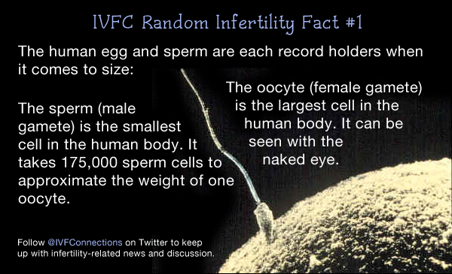
Sex cells

Slide 6
Sex cells/ gametes
Feature | Egg cell | Sperm cell
Size | Large | Small
Can it move | No | Yes – swims with a tail
Does it have a food store? | Yes | No
How many are produced? | Normally one each month | Millions every day
How many chromosomes? | 23 | 23

Slide 7
Adolenscence and puberty
Adolescence is is the period of transition between childhood and adulthood, during which significant physical, cognitive and psychosocial changes occur.
Puberty is the period during which humans become sexually mature.
It is initiated by hormonal signals from the brain to the gonads: the ovaries in a girl, the testes in a boy.
Besides maturation of the primary sex organs (those involved directly in reproduction), secondary sex characteristics also emerge during puberty. Boys develop adult male traits (such as facial hair), and girls develop adult female traits (such as breasts).
https://bio.libretexts.org/Bookshelves/Human_Biology/Book%3A_Human_Biology_(Wakim_and_Grewal)/23%3A_Human_Growth_and_Development/23.7%3A_Adolescence_and_Puberty
Notes:
Puberty may begin before adolescence, but it usually continues for several years, well into the adolescent stage, which ends during the late teens.
Puberty starts when the hypothalamus starts releasing pulses of gonadotropin-releasing hormone, which triggers the pituitary gland to secrete follicle
stimulating hormone (FSH) and luteinizing hormone (LH). FSH and LH, in turn, stimulate the gonads to develop and release sex hormones. Sex hormones bring about most of the other changes of puberty.

Slide 8
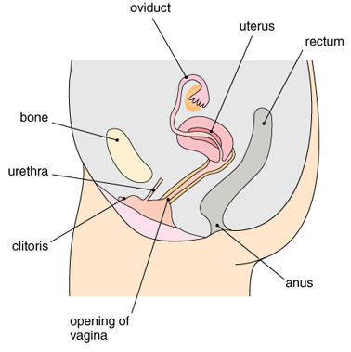
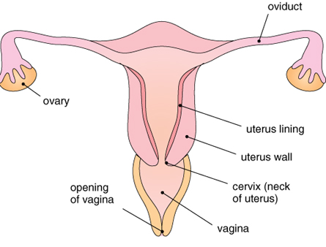
Female reproductive system

Slide 9
Female reproductive system
Name | Function
Ovary | Produces the female gametes - the eggs. Makes the female hormones oestrogen and progesterone.
Oviduct | It is also called Fallopian tube. The egg passes out through ovary and into the oviduct and this process called ovulation. Fertilisation takes place here.
Uterus | The foetus develops here.
Cervix | It is the lower end of the uterus and has a ring of muscle.
Vagina | It opens to the outsides of the body. This is where sperm cells are deposited during sexual intercourse.
Vulva | It is the outer part of a woman's sexual organs

Slide 10
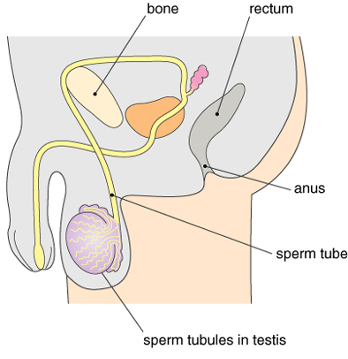
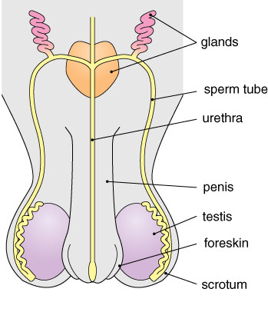
Male reproductive system
epididymis

Slide 11
Male reproductive system
Name | Description/Function
Glands | Add fluids to the sperm cells to keep them alive.
Sperm Duct | Sperm passes along the sperm ducts before entering the urethra.
Testes | Sperm cells are produced inside the testes. The hormone testosterone is also made here.
Scrotum | A sac hanging outside the body which contains the testes. This makes sure that the temperature is low enough for sperm production.
Penis | Blood pumped into the spongy tissue of the penis makes it erect. The penis must be erect for ejaculation (release of semen).

Slide 12
Male reproductive system
Name | Description/Function
Urethra | Urine and semen leave the body through the urethra. However, they cannot both pass down the urethra at the same time.
Epididymis | Stores sperm cells before they enter the sperm duct.
Semen | A fluid which contains sperm cells and fluids added from glands.
Sperm cells | These are the male gametes. They are produced in the testes and released as semen during ejaculation. Sperm cells have a “tail” which allows them to travel relatively far distances (for fertilization).

Slide 13
Sexual intercourse
Sperms are placed inside the woman’s body during sexual intercourse.
The erect penis is placed inside the vagina.
Sperms leave the testes and mix with fluid from the glands to make semen.
The semen is ejaculated into the vagina.
Each ejaculation include 250-300 millions of sperms/ sperm.

Slide 14
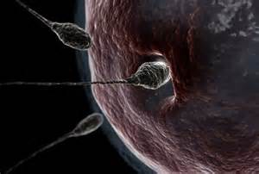
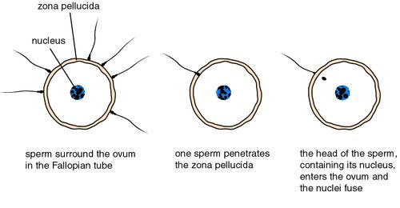
Fertilisation

Slide 15
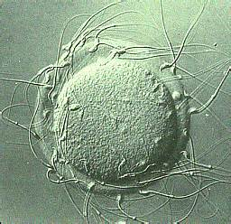
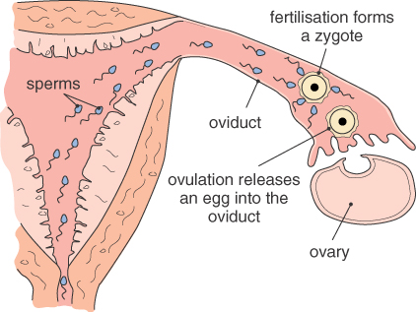
Fertilisation

Slide 16
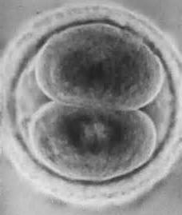
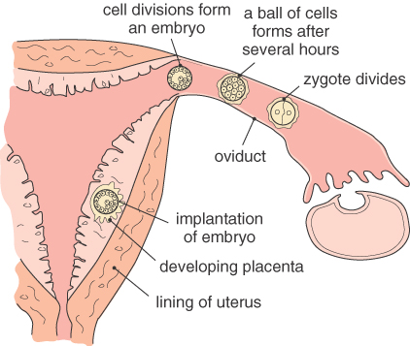
Implantation
https://www.medicoverfertility.in/blog/thin-endometrium,197,n,5475
Thin endometrium is the tissue that lines the inner layer of the uterus and is essential for reproduction because embryo implantation takes place here.
Notes:
The uterus is lined with three layers. The outer lining is called serosa, the middle layer myometrium and the innermost lining of the uterus is called the endometrium.

Slide 17
Question
Please describe the whole process from ovulation until implantation. (use terminology)
An egg is released from follicle into oviduct.
Peristalsis and cilia wafting help to move the egg through oviduct.
Fertilisation occur in oviduct. A sperm meet the egg, two nuclei fuse, forming a zygote.
The zygote starts to divide by mitosis, forming a ball of cells which is now called an embryo and continues moving towards the uterus.
The embryo (or blastocyst) sinks into the thick endometrium, which is called implantation.

Slide 18
Development of the fetus
All of the cells in embryo look identical when it first sinks into the endometrium.
Then the cells continue to divide and begin to develop into different types (specialisation/ differentiation) with different functions.
By 10 or 11 weeks after fertilisation, all of the organs are in place, and the embryo is now called a fetus.
Overall, the embryo increase complexity in the early stages and increase size towards the end of pregnancy.

Slide 19
Ante-natal care
Diet
Fe
Ca
Carbohydrates & proteins
Gentle exercise like walking, swimming
And so on.

Slide 20
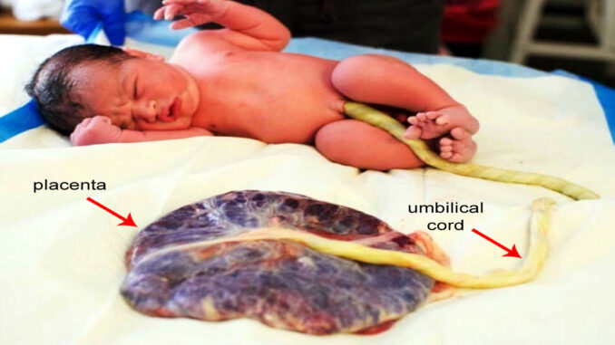
The placenta
There are 3 structures which are vital for development of human fetus: placenta, umbilical cord and amnion.

Slide 21
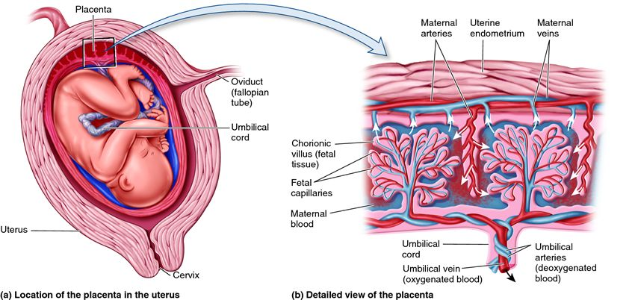
The placenta
Once the fetus sticks to the uterus inner surface, placenta starts growing and penetrating inside the uterus lining which is also known as endometrium.
Placenta forms with fetus. It grows with the baby.
Placenta is like the root that comes out of a germinating seed.
Notes:
The placenta is unique in that it is an organ which arises from the tissue of two genetically distinct organisms; part of the placenta develops from the tissue of the mother’s uterine wall, while another part develops from the fetus’ own tissue. After the blastocyst which will develop into the fetus makes contact with the uterine wall, blastocyst and maternal tissue grow together to form a single, cooperating organ that links the two together.
During childbirth, the contractions of the uterus cause the uterus to shrink in size but the placenta has no muscles and cannot shrink. The difference in size causes the placenta to tear loose and come out after the baby is born. Thus, the placenta is also called the after birth.

Slide 22
The placenta
Allow for substances exchange between mother and fetus, including nutrients supplying, waste elimination and gas exchanges.
Produces hormones that keep the mother’s body primed to support pregnancy.
Transfers antibodies from the mother to the fetus, conferring some immune protection.
Mother’s blood and fetus’s blood do not mix. They are separated by the placenta.
Provide a barrier of some toxins and pathogens. Unfortunately, the placenta is not fool-proof as an infection barrier, and some fetuses do become infected with diseases contracted by their mother. Toxins of sufficiently small molecular size like nicotine and alcohol can also pass through.

Slide 23
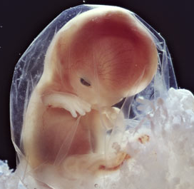
Pregnancy
The foetus becomes surrounded by a membrane called the amnion (also called amniotic sac, containing amniotic fluid).
Amnion
The amnion provides a sterile environment by preventing the entry of pathogens from the vagina.
Amniotic fluid

Slide 24
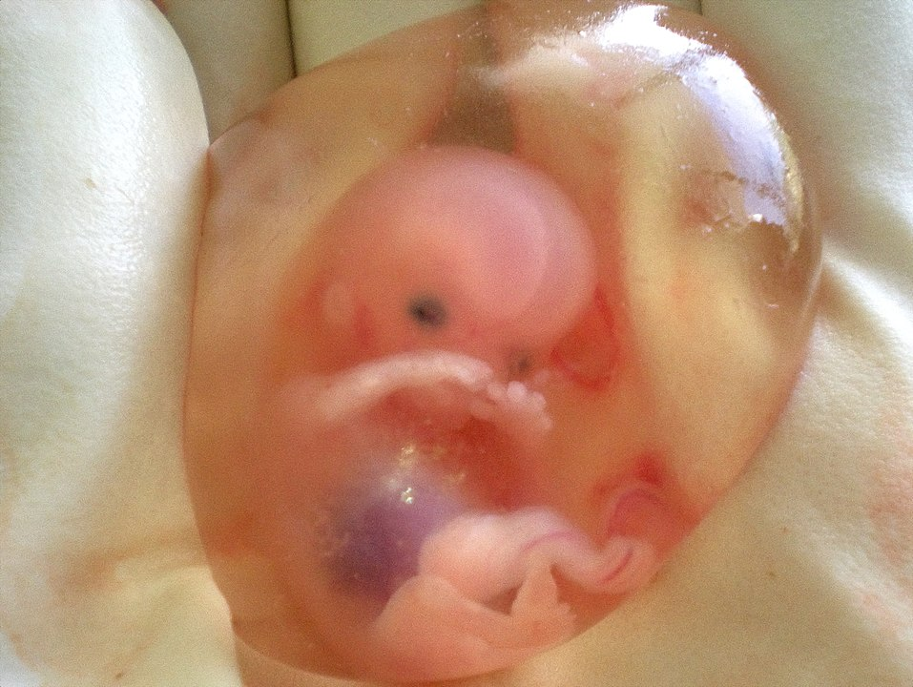
44-year-old pregnant woman with 6 previous children was diagnosed with carcinoma in situ of cervix (early-stage cancer of the uterus). The uterus (womb) was completely removed, including the fetus, to protect the health of the patient.

Slide 25
Pregnancy events
Ovulation
(Sexual intercourse)
Fertilisation
Implantation
Fetus development
Labour and birth:
breaking of the amniotic sac (water breaking)
contraction of the muscles in the uterus wall
dilation of the cervix
passage through the vagina
tying and cutting the umbilical cord
delivery of the afterbirth

Slide 26
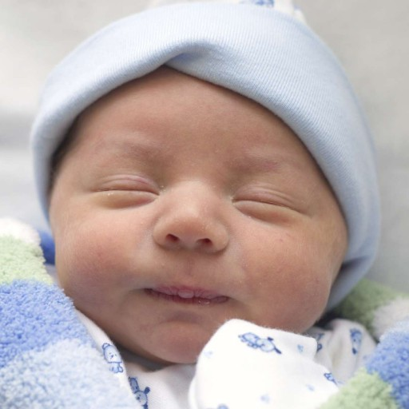
A happy ending.
Baby care:
Feed milk
Keep warm, not hot!
Enough sleep

Slide 27
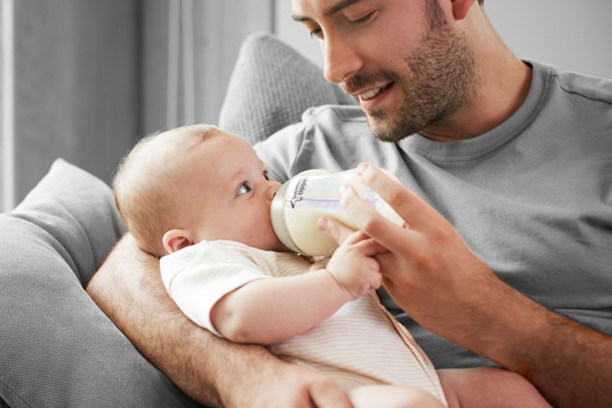
Breast feeding
Bottle feeding

Slide 28
Milk feeding
 | advantages | disadvantages
breast feeding | 1 free/ no cost; 2 contain antibodies (passive immunity); colostrum; 3 promote close bonding between mother & baby (emotional effect); 4 nutrients balanced/ complete nutrition for baby needs; most suitable food for babies, easy to digest; no additives; babies less likely to develop diabetes, less risk of allergies; 5 composition changes as baby grows; 6 at appropriate temperature; 7 sterile, free from infection/ contamination; 8 convenient, needs no preparation; 9 helps the mother’s body return to ‘normal’, e.g. weight loss, restore the uterus; contraceptive effect due to the hormone prolactin; 10 mothers are less likely to develop cancers of the breast, uterus and ovaries; | 1 mother is occupied/ mother cannot hand over feeding to other families; 2 the father cannot help with feeding the baby; 3 the mother may not be well enough to produce milk; 4 some mothers may not produce enough milk, or find it difficult, painful or embarrassing to breastfeed; 4 some virus can transfer in milk, e.g. HIV & hepatitis, also drugs & alcohol; 5 cannot see how much baby has consumed; 6 some dietary restrictions for mom;
bottle feeding (formula milk) | 1 convenient, can be made any time; 2 if mother cannot produce enough breast milk; if mother is infected, such as HIV; 3 allow other family members to help & bond with the baby; 4 know the volume baby has consumed; | 1 the bottle/ equipment needs to be kept clean/ sterile, or it will be easy to make the baby ill; 2 expensive; 3 time-consuming as to preparation;

